Slide 1
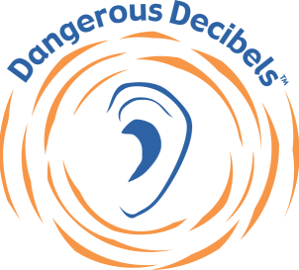
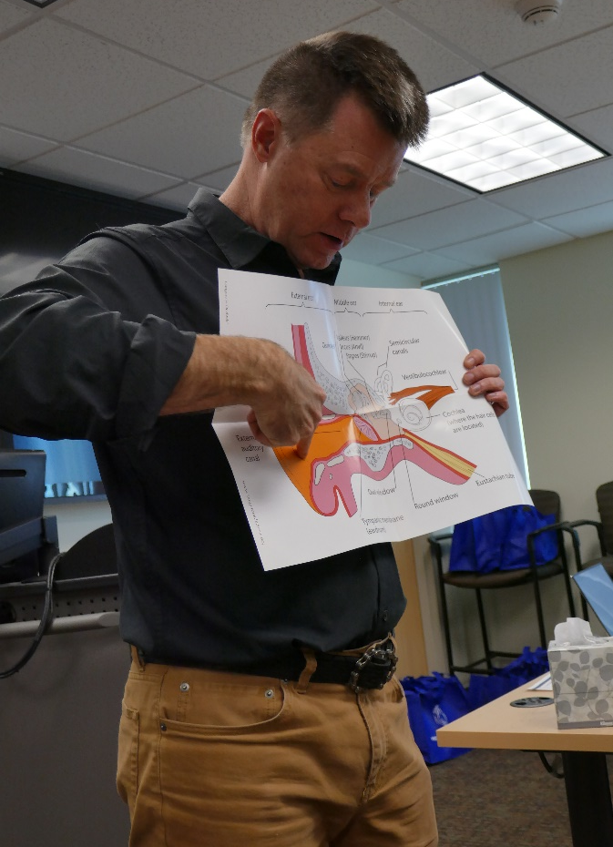
To arrange a classroom presentation please call or email one of our
Certified Dangerous Decibels Educators:
[ADD YOUR CONTACT INFORMATION HERE]
The Dangerous Decibels® mission is to significantly reduce the prevalence of noise-induced hearing loss and tinnitus (ringing in the ear) through exhibits, education, and research.
INTERACTIVE CLASSROOM PROGRAM
www.dangerousdecibels.org
Developed with National Institutes of Health (NIH) grants and through an early partnership with the Oregon Museum of Science and Industry. (OMSI).

Slide 2
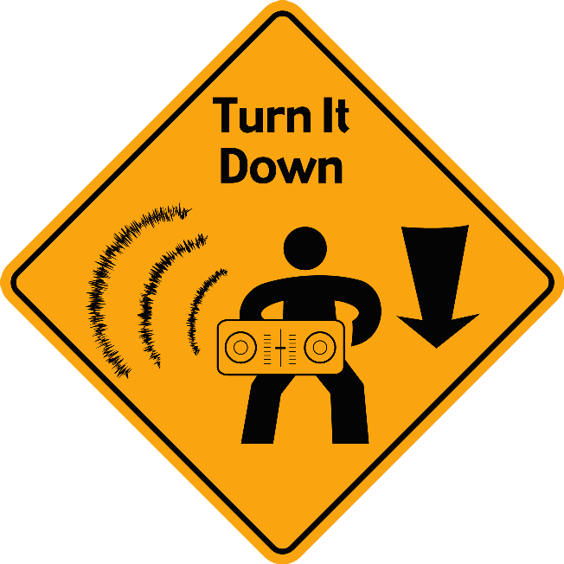
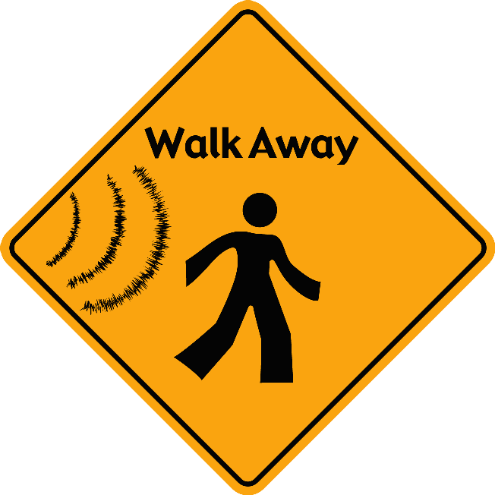
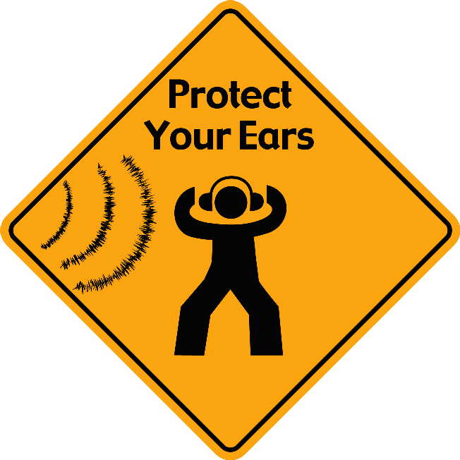
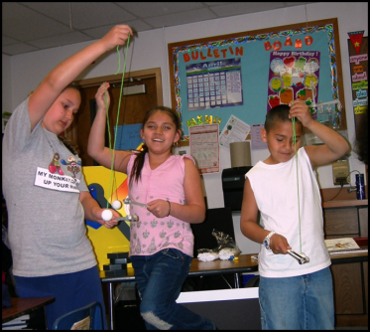
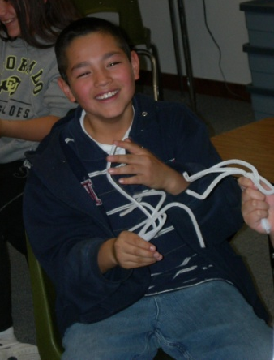
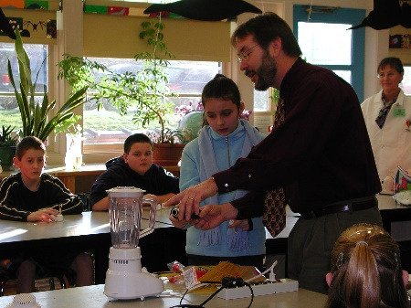
Did You Know?...
The program teaches students the concept of noise-induced hearing loss and just how important it is to use three strategies to protect their hearing;
North American children “may receive more noise at school than workers from an 8-hour work day at a factory”
Report of a World Health Organization-Prevention of Deafness/Hearing Impairment Informal Consultation III, WHO, Geneva, 1997
Join us in our efforts
to prevent noise-induced hearing loss and tinnitus
The presentation is about 50 minutes long and uses the principals of inquiry-based learning to teach the concepts of noise-induced hearing loss prevention. Using scientific tools, students measure sound, learn about decibels, and make models of their own ear. They explore the sound, the way it travels, and how they can protect their hearing for years to come!
Approximately 12.8 % of 12- to 19-year-olds in the U.S. have documented evidence of elevated hearing thresholds attributed to noise exposure.
Su, B. M., & Chan, D. K. (2017). Prevalence of hearing loss in US children and adolescents: findings from NHANES 1988-2010. JAMA Otolaryngology–Head & Neck Surgery, 143(9), 920-927.
The Dangerous Decibels® classroom program has been tested for effectiveness throughout its development. This fun and interactive presentation is very effective in positively changing knowledge, attitudes, and intended behaviors regarding hearing health in 4th and 7th grade classrooms.
An estimated 5.9 million youth aged 9-19 years in the U.S. have documented evidence of elevated hearing thresholds directly attributed to noise exposure.
Meinke, D.K. (2021) “Prevention of Noise-Induced Hearing Loss and Tinnitus in Youth”. In Johnson, C.D. and Seaton, J.B (Eds.), Educational Audiology Handbook 3rd Edition, Plural Publishing. San Diego, CA. pp 447-458.
Bring the
Dangerous Decibels program to a classroom in your community!
7.5 % of 12- to 19-year-olds in the U.S. have tinnitus which represents about 2.5 million adolescents.
Mahboubi, H., Oliaei, S., Kiumehr, S., Dwabe, S., & Djalilian, H. R. (2013). The prevalence and characteristics of tinnitus in the youth population of the United States. The Laryngoscope, 123(8), 2001-2008.

Slide 3
Alexys, we could use this image and content from the online training to replace the 2nd and 3rd yellow text boxes

